Slide 1
SUPPLIER RELATIONSHIP MANAGEMENT
PRODUCT OVERVIEW

Slide 2
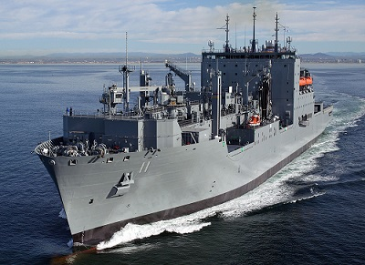
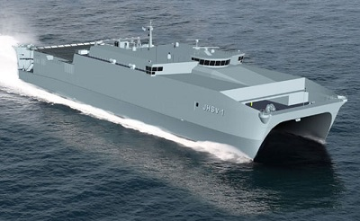
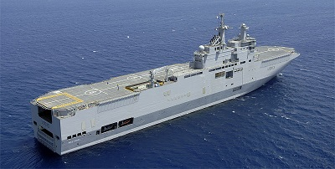
Bridge
Funnel
Water line
Bulbous
Crane
Hull
Star Board
Port Side
Structure
Deck
Forecastle
Bulk Head
Manufacturing Requirements

Slide 3

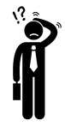
PART X
PART X
PART X
PART X
PART X
PART X
PART X
PART X

Slide 4



SRM
CSM
PN
PS
SS

Slide 5
SRM - PRODUCTS
Component Supplier Management (CSM)
. Part Navigator (PN)
Product Sourcing (PS)
Is a Catalog and content search tool
Helps maintain information about parts and organizations
Search for them, analyze them and modify them
A fast and flexible way to quickly locate parts of interest within the SRM Database.
Optimize products for lowest cost & supply risk by evaluating & selecting the best parts, suppliers & sourcing strategy
Allows rapid product change, Bill of Material (BOM) collaboration, Life Cycle Management (LCM) in collaborative manner
Strategic Sourcing (SS)
Contract Manufacturing (CM)
Arms an enterprise with the tools, critical knowledge and supporting business processes
Enables organizations to manage contracts at global and local levels
Track contract performance to reduce operational cost
Ensure compliance to drive direct savings to the bottom-line.

Slide 6
Updates
Defense Federal Acquisition Regulation Supplement (DFARS) Compliance
One way password encryption – Testing and preparation for release
2017.1.0.1 – April 2018
2017.1.1.0 – SRM 2017 release on WebSphere
May 2018
Innovation Day
Idea – Automated BOM recommendation following up for patenting.
Customer issue support (Ingalls)

